Slide 1
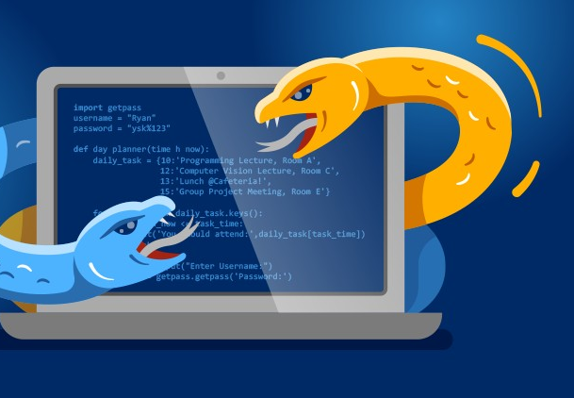

Python Fundamentals
By Yilmaz Mustafa

Slide 2
Decorators
Python Fundamentals
www.intecbrussel.be | yilmaz.mustafa@intecbrussel.be

Slide 3
Python Fundamentals
Let’s now discuss a more advanced Python topic: Decorators.
Decorators allow you to “decorate” a function, let’s discuss what that word means in this context.
www.intecbrussel.be | yilmaz.mustafa@intecbrussel.be

Slide 4
Python Fundamentals
Imagine you created a function:
def simple_func():
#: # Do simple stuff
Preturn something
www.intecbrussel.be | yilmaz.mustafa@intecbrussel.be

Slide 5
Python Fundamentals
Now you want to add some new capabilities to the function:
def simple_func():
# Want to do more stuff!
#: # Do simple stuff
Preturn something
www.intecbrussel.be | yilmaz.mustafa@intecbrussel.be

Slide 6
Python Fundamentals
You now have two options:
Add that extra code (functionality) to your old function.
Create a brand new function that contains the old code, and then add new code to that.
www.intecbrussel.be | yilmaz.mustafa@intecbrussel.be

Slide 7
Python Fundamentals
But what if you then want to remove that extra “functionality”.
You would need to delete it manually, or make sure to have the old function.
Is there a better way? Maybe an on/off switch to quickly add this functionality?
www.intecbrussel.be | yilmaz.mustafa@intecbrussel.be

Slide 8
Python Fundamentals
Python has decorators that allow you to tack on extra functionality to an already existing function.
They use the @ operator and are then placed on top of the original function.
www.intecbrussel.be | yilmaz.mustafa@intecbrussel.be

Slide 9
Python Fundamentals
Now you can easily add on extra functionality with a decorator:
@some_decorator
def simple_func():
#: # Do simple stuff
Preturn something
www.intecbrussel.be | yilmaz.mustafa@intecbrussel.be

Slide 10
Python Fundamentals
This idea is pretty abstract in practice with Python syntax, so we will go through the steps of manually building out a decorator ourselves, to show what the @ operator is doing behind the scenes.
www.intecbrussel.be | yilmaz.mustafa@intecbrussel.be

Slide 11
Python Fundamentals
Keep in mind you won’t encounter decorators in basic Python code.
They are common to encounter when working with Web Frameworks, such as Django or Flask.
www.intecbrussel.be | yilmaz.mustafa@intecbrussel.be

Slide 12

Python Fundamentals
www.intecbrussel.be | yilmaz.mustafa@intecbrussel.be

